Slide 1
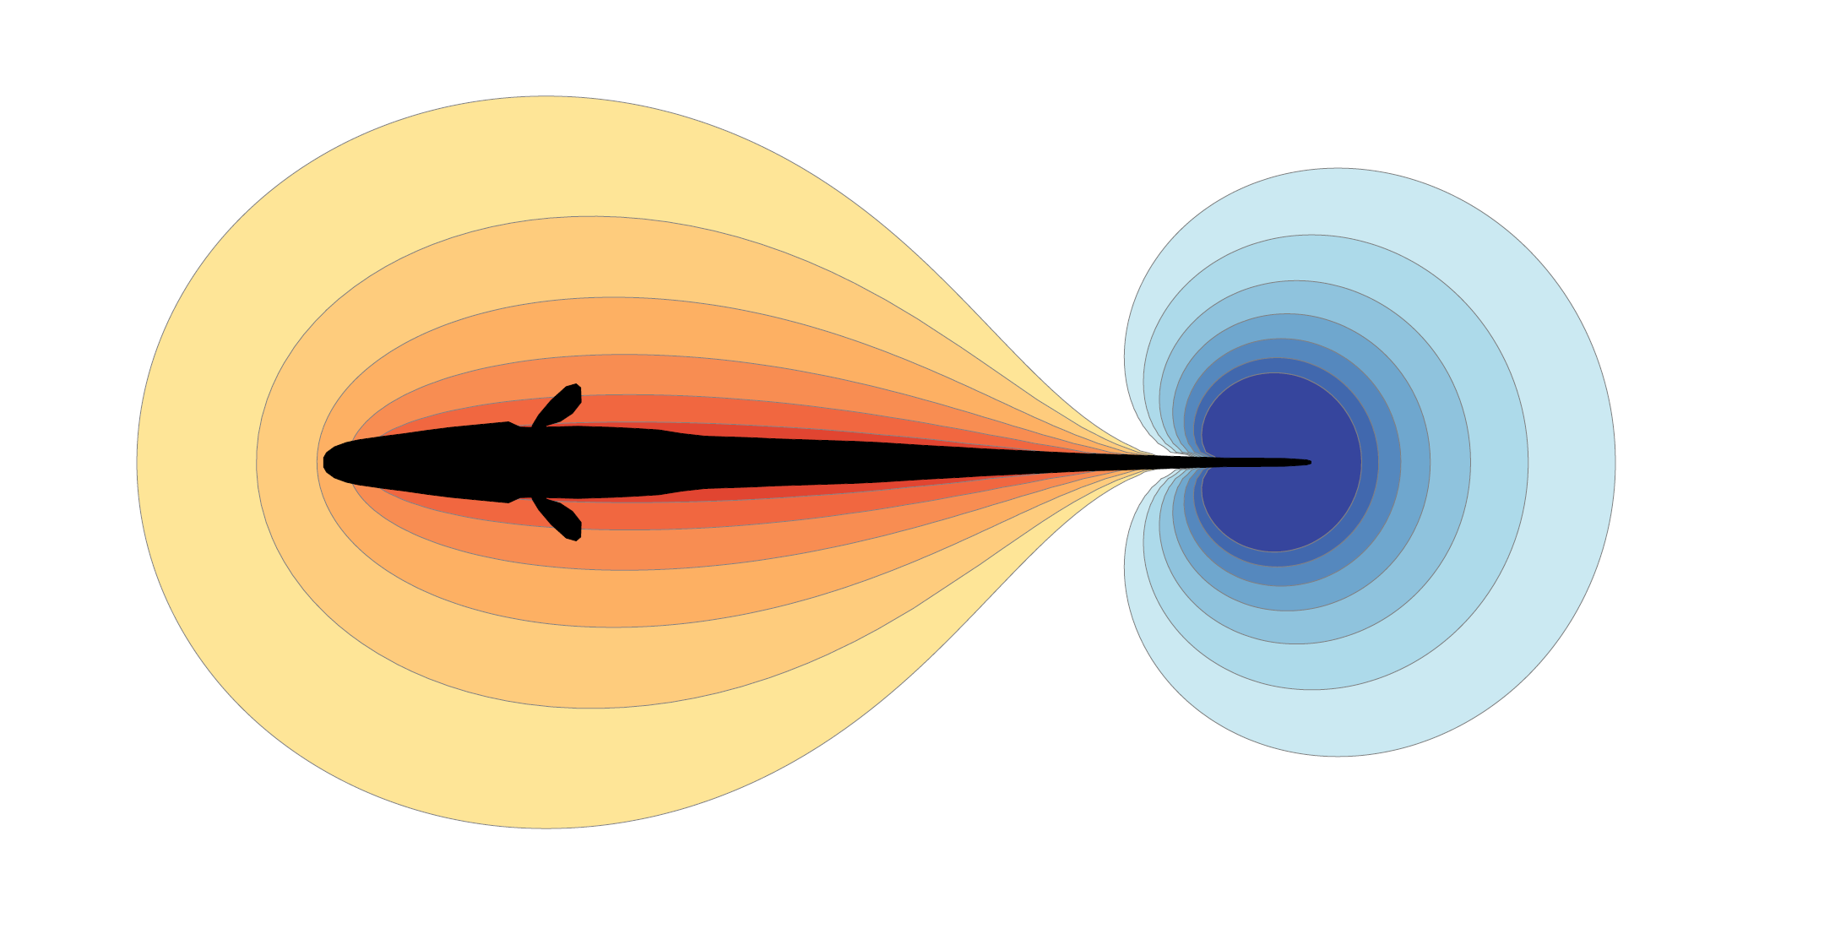
P-unit recording
Global EOD
Stimulation
Computer
Local EOD

Slide 2
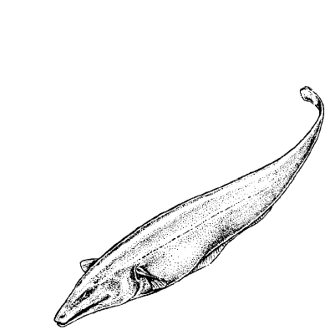
P-unit recording
Amplification
Global EOD
Amplification
Stimulation
PC
Local EOD
Amplification

